Slide 1
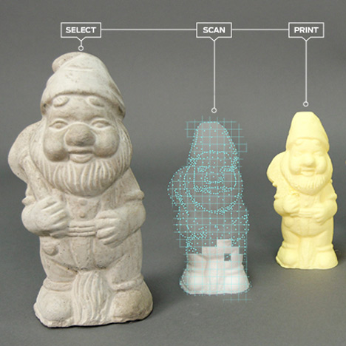
3D Scanner
Takes real-world object and to construct a three dimensional computer model
Applicable for reverse engineering mechanical parts
Reproduce models that can be then 3D printed

Slide 2
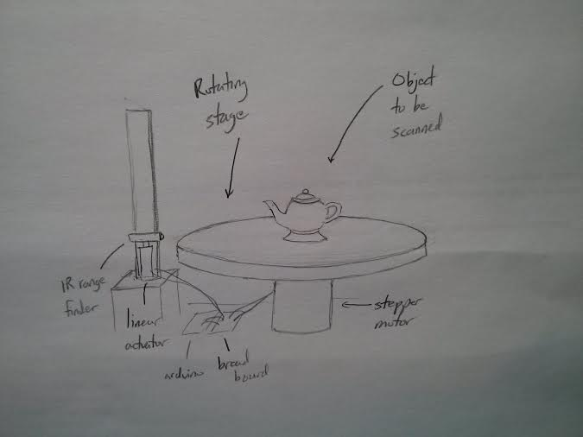
SPECIFICATIONS
Infrared range finder to measure distance
Motor with angular position encoder to rotate stage
Linear actuator to vary scan level height

